Slide 1
Pointers & Link Lists
Lecture 3

Slide 2
Pointer
A pointer is a variable that contains the address of a another variable.

Slide 3
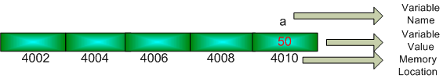
Pointer
Let us imagine that computer memory is a long array and every array location has a distinct memory location.
int a = 50 // initialize variable a
It is like a house which has an address and this house has only one room. So the full address is-
Name of the house: a
Name of the person/value who live here is: 50
House Number: 4010

Slide 4
Pointer
If we want to change the person/value of this house, the conventional way is, type this code line
a = 100 // new initialization
But using pointer we can directly go to the memory location of 'a' and change the person/value of this house without disturbing ‘a’.

Slide 5
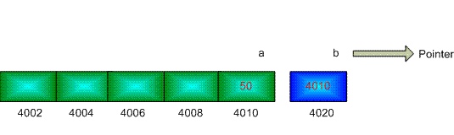
Pointer Declaration
int *b; // declare pointer b
We transfer the memory location of a to b.
b = &a; // the unary operator & gives the address of an object

Slide 6
Pointer Declaration
we can change the value of a without accessing a.
b = 100; // change the value of 'a' using pointer ‘b’
cout<<a; // show the output of 'a‘
int **c; //declare a pointer to a pointer
c = &b; //transfer the address of ‘b’ to ‘c’

Slide 7
Link list (Introduction)
payload
next
payload
next
payload
payload
next
next
In a linked list there are different numbers of nodes.
Each node consists of two fields.
The first field holds the value or data and the second field holds the reference to the next node or null if the linked list is empty.
Notes:
Linked list is one of the fundamental data structures, and can be used to implement other data structures.

Slide 8
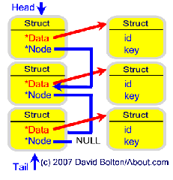
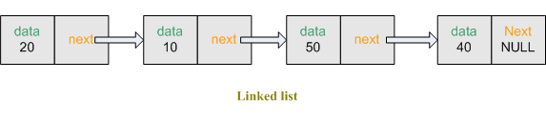
Link list (Introduction)
Linkedlist Node {
data // The value or data stored in the node
next // A reference to the next node, null for last node
}
typedef struct node
{
int data; // will store information
node *next; // the reference to the next node
};

Slide 9
Types of link list
Singly Link List
Doubly Link List
Circular Link List
Circular Doubly Link List

Slide 10
Singly-linked lists
Here is a singly-linked list (SLL):
myList
a
b
c
d
Each node contains a value and a link to its successor (the last node has no successor)
The header points to the first node in the list (or contains the null link if the list is empty)

Slide 11
Characteristics
Insert and delete nodes in any order
The nodes are connected
Each node has two components
Information (data)
Link to the next node
The nodes are accessed through the links between them

Slide 12
Head
Predecessor of X
Node X
Success-or of X
tail
For each node the node that is in front of it is called predecessor.
The node that is after it is called successor.

Slide 13
Terminology
Head (front, first node):
The node without predecessor, the node that starts the lists.
Tail (end, last node):
The node that has no successor, the last node in the list.
Current node: The node being processed.
From the current node we can access the next node.
Empty list: No nodes exist

Slide 14
Linked list operations
Traverse
Insert
Delete
Update

Slide 15
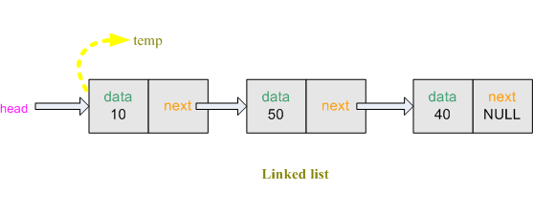
Traversing in link list
while( temp1!=NULL )
{
cout<< temp1->data<<" "; // show the data in the linked list
temp1 = temp1->next; // transfer the address of 'temp->next' to 'temp'
}
Notes:
We create node *temp1. Transfer the address of *head to *temp1. So *temp1 is also pointed at the front of the linked list. Linked list has 3 nodes.
We can get the data from first node using temp1->data. To get data from second node, we shift *temp1 to the second node. Now we can get the data from second node.

Slide 16
Algorithm
Suppose START is the address of the first node in the linked list. Following algorithm will visit all nodes from the START node to the end.
If (START is equal to NULL)
(a) Display “The list is Empty”
(b) Exit
Initialize TEMP = START
Repeat the step 4 and 5 until (TEMP == NULL )
Display “TEMP → DATA”
TEMP = TEMP → Next
Exit

Slide 17
ALGORITHM FOR SEARCHING A NODE
Suppose START is the address of the first node in the linked list and DATA is the information to be searched. After searching, if the DATA is found, POS will contain the corresponding position in the list.
Input the DATA to be searched
Initialize TEMP = START; POS =1;
Repeat the step 4, 5 and 6 until (TEMP is equal to NULL)
If (TEMP → DATA is equal to DATA)
(a) Display “The data is found at POS”
(b) Exit
TEMP = TEMP → Next
POS = POS+1
If (TEMP is equal to NULL)
(a) Display “The data is not found in the list”
Exit

Slide 18
Insertion in link list
01- Insert as the new first node
02- Insert as the new last node
03- Insert after specified number of nodes

Slide 19
01- Insert as the new first node
Steps:
Create a Node
Set the node data Values
Connect the pointers

Slide 20
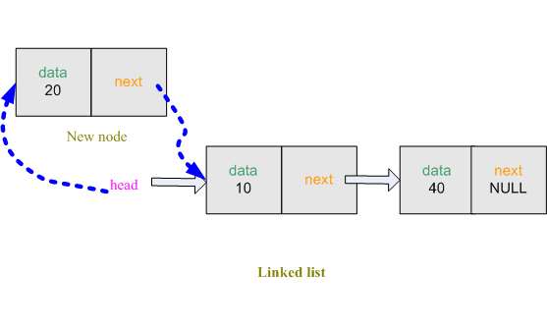
01- Insert as the new first node
Notes:
Then we take the data input from the user and store in the node info variable. Create a temporary node node *temp and allocate space for it.
-Then place info to temp->data. So the first field of the node *temp is filled. Now temp->next must become a part of the remaining linked list (although now linked list is empty but imagine that we have a 2 node linked list and head is pointed at the front) So temp->next must copy the address of the *head (Because we want Delete at first) and we also want that *head will always point at front. So *head must copy the address of the node *temp.

Slide 21
Algorithm
Insert a Node at the beginning
Input DATA to be inserted
Create a NewNode
NewNode → DATA = DATA
If (START equal to NULL)
(a) NewNode → Link = NULL
5. Else
(a) NewNode → Link = START
6. START = NewNode
7. Exit

Slide 22
01- Insert as the new first node
01- node *head = NULL; //empty linked list
02- node *temp; //create a temporary node
temp = (node*)malloc(sizeof(node)); //allocate space for node
03- temp->data = info; // store data (first field)
temp->next=head; // store the address of the pointer head (second field)
head = temp; // transfer the address of 'temp' to 'head'
Notes:
Then we take the data input from the user and store in the node info variable. Create a temporary node node *temp and allocate space for it.

Slide 23

02- Insert as the new last node
node *temp1; // create a temporary node
temp1=(node*)malloc(sizeof(node)); // allocate space for node
temp1 = head; // transfer the address of 'head' to 'temp1‘
while(temp1->next!=NULL) // go to the last node
temp1 = temp1->next; //transfer the address of 'temp1->next' to 'temp1'
Notes:
Create a temporary node node *temp and allocate space for it. Then place info to temp->data, so the first field of the node node *temp is filled. node *temp will be the last node of the linked list. For this reason, temp->next will be NULL. To create a connection between linked list and the new node, the last node of the existing linked list node *temp1`s second field temp1->next is pointed to node *temp.

Slide 24
Algorithm
Insert a Node at the end
Input DATA to be inserted
Create a NewNode
NewNode → DATA = DATA
NewNode → Next = NULL
If (START equal to NULL)
(a) START = NewNode
Else
(a) TEMP = START
(b) While (TEMP → Next not equal to NULL)
(i) TEMP = TEMP → Next
TEMP → Next = NewNode
Exit

Slide 25
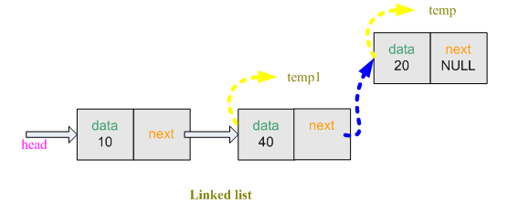
02- Insert as the new last node
node *temp; // create a temporary node
temp = (node*)malloc(sizeof(node)); // allocate space for node
temp->data = info; // store data(first field)
temp->next = NULL; // second field will be null(last node)
temp1->next = temp; // 'temp' node will be the last node

Slide 26
03- Insert after specified number of nodes
cout<<"ENTER THE NODE NUMBER:";
cin>>node_number; // take the node number from user
node *temp1; // create a temporary node
temp1 = (node*)malloc(sizeof(node)); // allocate space for node
temp1 = head;
for( int i = 1 ; i < node_number ; i++ )
{
temp1 = temp1->next; // go to the next node
if( temp1 == NULL )
{
cout<<node_number<<" node is not exist"<< endl;
break;
}
}

Slide 27
Algorithm
Insert a Node at any specified position
1. Input DATA and POS to be inserted
2. initialize TEMP = START; and j = 0
3. Repeat the step 3 while( k is less than POS)
(a) TEMP = TEMP è Next
(b) If (TEMP is equal to NULL)
(i) Display “Node in the list less than the position”
(ii) Exit
(c) k = k + 1
4. Create a New Node
5. NewNode → DATA = DATA
6. NewNode → Next = TEMP → Next
7. TEMP → Next = NewNode
8. Exit

Slide 28
03-Insert after specified number of nodes
Create a temporary node node *temp and allocate space for it. Then place info to temp->next , so the first field of the node node *temp is filled.
node *temp; // create a temporary node
temp = (node*)malloc(sizeof(node)); // allocate space for node
temp->data = info; // store data(first field)

Slide 29
03-Insert after specified number of nodes
temp->next = temp1->next; //transfer the address of temp1->next to temp->next
temp1->next = temp; //transfer the address of temp to temp1->next
Notes:
To establish the connection between new node and the existing linked list, new node’s next must pointed to the 2nd node’s (temp1) next . The 2nd node’s (temp1) next must pointed to the new node(temp).

Slide 30
Deletion in link list
01- Delete from front
02- Delete from back
03-Delete after specified number of nodes

Slide 31
01- Delete from front
Steps
Break the pointer connection
Re-connect the nodes
Delete the node

Slide 32
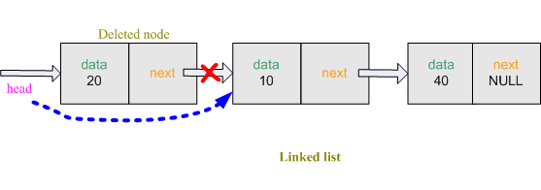
01- Delete from front

Slide 33
01- Delete from front
node *temp; // create a temporary node
temp = (node*)malloc(sizeof(node)); // allocate space for node
temp = head; // transfer the address of 'head' to 'temp‘
head = temp->next; // transfer the address of 'temp->next‘ to 'head‘
free(temp);

Slide 34
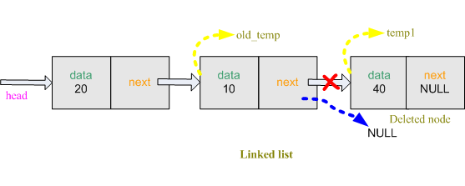
02- Delete from back

Slide 35
02- Delete from back
// create a temporary node
node *temp1;
temp1 = (node*)malloc(sizeof(node)); // allocate space for node
temp1 = head; //transfer the address of head to temp1
node *old_temp; // create a temporary node
old_temp = (node*)malloc(sizeof(node)); // allocate space for node
while(temp1->next!=NULL) // go to the last node
{
old_temp = temp1; // transfer the address of 'temp1' to 'old_temp'
temp1 = temp1->next; // transfer the address of 'temp1->next' to 'temp1'
}

Slide 36
02- Delete from back
old_temp->next = NULL; // previous node of the last node is null
free(temp1);

Slide 37
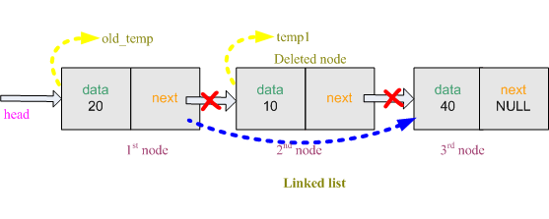
03- Delete specified number of node

Slide 38
node *temp1; // create a temporary node
temp1 = (node*)malloc(sizeof(node)); // allocate space for node
temp1 = head; // transfer the address of 'head' to 'temp1'
node *old_temp; // create a temporary node
old_temp = (node*)malloc(sizeof(node)); // allocate space for node
old_temp = temp1; // transfer the address of 'temp1' to 'old_temp‘
cout<<"ENTER THE NODE NUMBER:";
cin>>node_number; // take location
for( int i = 1 ; i < node_number ; i++ )
{
old_temp = temp1; // store previous node
temp1 = temp1->next; // store current node
}

Slide 39
03-Delete specified number of node
old_temp->next = temp1->next; // transfer the address of 'temp1->next' to 'old_temp->next‘
free(temp1);

Slide 40
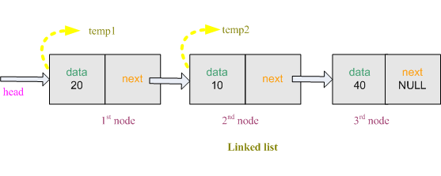
04- Sort nodes

Slide 41
node *temp1; // create a temporary node
temp1 = (node*)malloc(sizeof(node)); // allocate space for node
node *temp2; // create a temporary node
temp2 = (node*)malloc(sizeof(node)); // allocate space for node
int temp = 0; // store temporary data value
for( temp1 = head ; temp1!=NULL ; temp1 = temp1->next )
{
for( temp2 = temp1->next ; temp2!=NULL ; temp2 = temp2->next )
{
if( temp1->data > temp2->data )
{
temp = temp1->data;
temp1->data = temp2->data;
temp2->data = temp;
}
}
}

Slide 42
Doubly-linked lists
prev
next
Here is a doubly-linked list (DLL):
elem
node
header
nodes/positions
trailer
elements
Each node contains a value, a link to its successor (if any), and a link to its predecessor (if any)
The header points to the first node in the list and to the last node in the list (or contains null links if the list is empty)

Slide 43
Doubly Linked Lists
pHead
a
b
c
Advantages:
Convenient to traverse the list backwards.
Simplifies insertion and deletion because you no longer have to refer to the previous node.
Disadvantage:
Increase in space requirements.

Slide 44
Insertion
head
current
newNode = new Node(x);
newNode->prev = current;
newNode->next = current->next;
newNode->prev->next = newNode;
newNode->next->prev = newNode;
current = newNode;
newNode

Slide 45
Insertion
We visualize operation insertAfter(p, X), which returns position q
p
A
B
C
p
A
B
q
C
X
p
q
A
B
X
C

Slide 46
ALGORITHM FOR INSERTING A NODE
Suppose START is the first position in linked list. Let DATA be the element to be
inserted in the new node. POS is the position where the NewNode is to be inserted. TEMP
is a temporary pointer to hold the node address.
Input the DATA and POS
Initialize TEMP = START; i = 0
Repeat the step 4 if (i less than POS) and (TEMP is not equal to NULL)
TEMP = TEMP → RPoint; i = i +1
If (TEMP not equal to NULL) and (i equal to POS)
(a) Create a New Node
(b) NewNode → DATA = DATA
(c) NewNode → RPoint = TEMP → RPoint
(d) NewNode → LPoint = TEMP
(e) (TEMP → RPoint) → LPoint = NewNode
(f ) TEMP → RPoint = New Node
Else
(a) Display “Position NOT found”
7. Exit

Slide 47
Deletion
We visualize remove(p), where p == last()
p
A
B
C
D
A
B
C
p
D
A
B
C

Slide 48
Deletion
head
current
oldNode = current;
oldNode->prev->next = oldNode->next;
oldNode->next->prev = oldNode->prev;
delete oldNode;
current = head;

Slide 49
ALGORITHM FOR DELETING A NODE
Suppose START is the address of the first node in the linked list. Let POS is the position of the node to be deleted. TEMP is the temporary pointer to hold the address of the node. After deletion, DATA will contain the information on the deleted node.
Input the POS
Initialize TEMP = START; i = 0
Repeat the step 4 if (i less than POS) and (TEMP is not equal to NULL)
TEMP = TEMP → RPoint; i = i +1
If (TEMP not equal to NULL) and (i equal to POS)
(a) Create a New Node
(b) NewNode → DATA = DATA
(c) NewNode → RPoint = TEMP → RPoint
(d) NewNode → LPoint = TEMP
(e) (TEMP → RPoint) → LPoint = NewNode
(f ) TEMP → RPoint = New Node
6. Else
(a) Display “Position NOT found”
7. Exit

Slide 50
DLLs compared to SLLs
Advantages:
Can be traversed in either direction (may be essential for some programs)
Some operations, such as deletion and inserting before a node, become easier
Disadvantages:
Requires more space
List manipulations are slower (because more links must be changed)
Greater chance of having bugs (because more links must be manipulated)

Slide 51
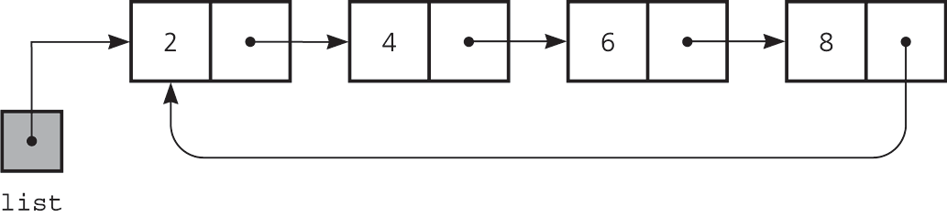
Circular Linked Lists
Last node references the first node
Every node has a successor
No node in a circular linked list contains NULL
A circular linked list

Slide 52
Circular Doubly Linked Lists
Circular doubly linked list
prev pointer of the dummy head node points to the last node
next reference of the last node points to the dummy head node
No special cases for insertions and deletions

Slide 53
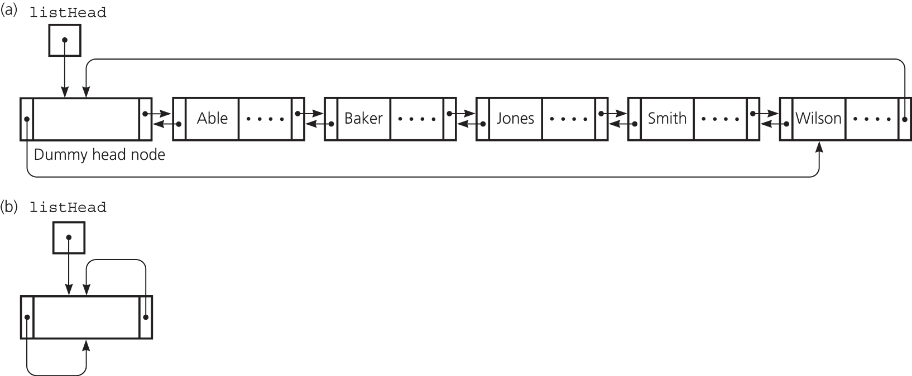
Circular Doubly Linked Lists
(a) A circular doubly linked list with a dummy head node
(b) An empty list with a dummy head node

Slide 54
Sources used
Lectures by Mr. Mohammad Asad Abbasi

